Slide 1


INTM575- DATA WAREHOUSING
AND DATA MINING
Case Study
Data ware Thouse implementation
strategy for PHILLIPS HEALTHCARE
Submitted By
S IM R A N S H A R M A - A 0 9
P R A T Y A K S H M IS H R A - B 3 2 S H A IK P S H E H Z A D - B 48

Slide 2




What is Data Warehousing ?
PHILLIPS HEALTHCARE
In order to support business intelligence tasks like reporting, analysis, and decision-making, huge and diverse sets of data from numerous sources are gathered, stored, and managed in a centralised repository. This process is known as data warehousing. With a focus on historical
data and procedures optimisation.
long-term analysis, it entails
like ETL, data modelling, and A unified picture of an
organization's data is intended to improved insights and decision-making.
enable

Slide 3
Data Warehouse in today’s world are helping companies across industries to make data-
PHILLIPS HEALTHCARE
Case Study:
Data warehouse implementation strategy for
Phillips
Healthcare.
driven decisions. For the healthcare industry experiencing a massive shift towards consumerism and advanced analytics, a single & comprehensive view of data is becoming imperative. It is one of the many reasons why leading healthcare organizations are beginning to implement enterprise healthcare data warehouses in their structure.
It helps them to constantly improve patient outcomes and reduce costs. Further, the effective use of the data gathered over the years helps increase operational efficiency, optimize infrastructure investments and improve customer experience.

Slide 4






Attributes and Data Model
PHILLIPS HEALTHCARE
Constructing a data warehouse for Phillips Healthcare begins with identifying the necessary qualities and data model, including patient demographics, medical history, diagnosis, treatments, and drugs. A standardized and consistent data model is essential to ensure data correctness and integrity, which can be achieved through a data dictionary outlining data pieces, types, relationships, and quality guidelines. Depending on complexity, a star or snowflake structure can be used, and data marts should be developed to store data for specific business units or departments. The characteristics and data model provide a structure for managing and organizing data, enabling advanced analytics and reporting capabilities.
IN THIS CASE, THE ATTRIBUTES INCLUDE:
01
Patient Demographics
02
Medical History
03
Medication
04
Diagnoses
05
Treatments

Slide 5

DATA COLLECTION
PHILLIPS HEALTHCARE
Data collection is the next step, and it involves using a variety of systems, including electronic medical records (EMRs), laboratory information systems (LIS), radiology information systems (RIS), pharmacy information systems (PIS), and other clinical and administrative ones. Using ETL (extract, transform, load) technologies, the data should be cleaned, converted, and loaded into the data warehouse. To guarantee data accuracy and timeliness, the ETL procedure should be automated.
Regulations like HIPAA should be followed in terms of the data collection.
In relation to the Phillips Healthcare case study, several methods for gathering data include:
ETL (extract, transform, load) is a technique used to collect data from multiple source systems and load it into a data warehouse. The process involves extracting data from source systems, converting it into a common format, and loading it into the data warehouse. Phillips Healthcare could use ETL to extract data from finance systems, EHR systems, and other sources.
Change Data Capture (CDC) is a method used to capture real-time data changes and transmit them to a data warehouse. This technique is useful when data in source systems changes frequently and needs to be updated immediately in the data warehouse. For example, CDC can track changes in a patient's insurance information in the EHR system and update the relevant record in the data warehouse.

Slide 6
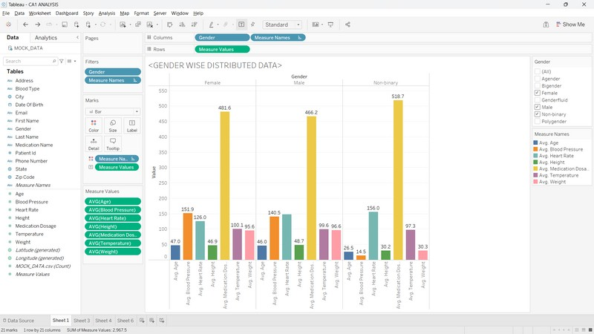

GENDER WISE DISTRIBUTED DATA
PHILLIPS HEALTHCARE
We have performed Gender wise analysis on the attributes AGE, BP, TEMPERATURE, etc.
As per our analysis we find that the female with the average age of 47 years tend to take more medication dose of around 481.6 due to moderately high blood pressure and heart rate.
On the other hand the male population take comparatively less medication dosage.

Slide 7
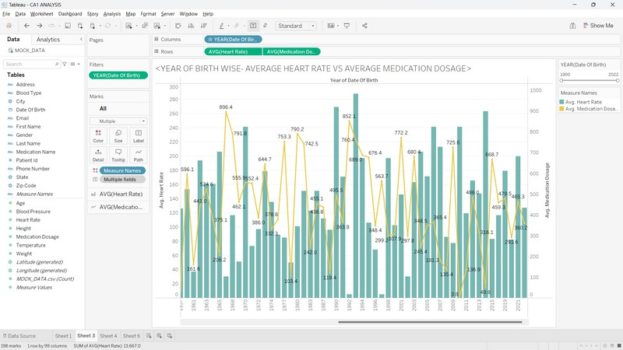
YEAR OF BIRTH WISE- AVERAGE HEART RATE VS AVERAGE MEDICATION DOSAGE
PHILLIPS HEALTHCARE
As per analysis the Average heart rate of people from recent years that is 2019, 2020, 2022 has decreased, due to covid.

Slide 8
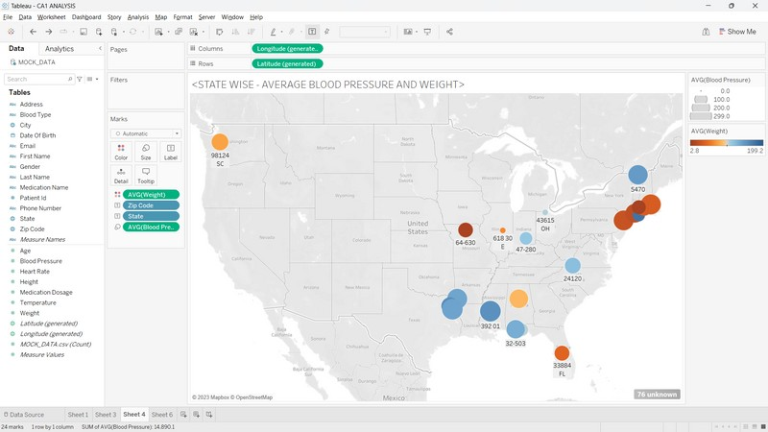

STATE WISE - AVERAGE BLOOD PRESSURE AND WEIGHT
PHILLIPS HEALTHCARE
As per our analysis eastern part of the USA has more obese people and hence the average weight is more in those countries.

Slide 9
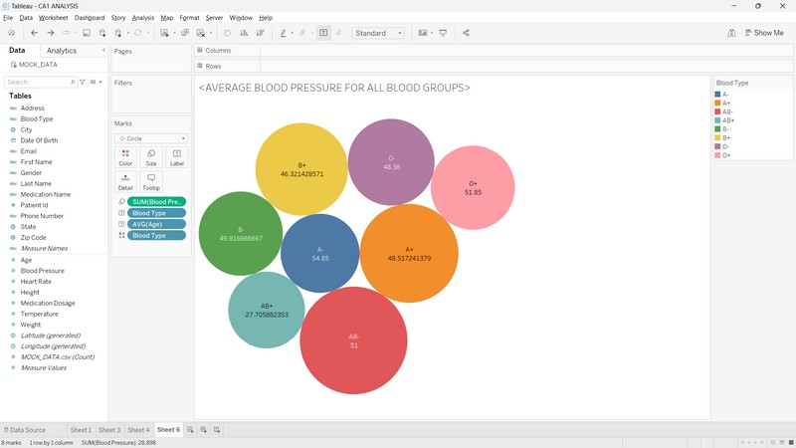
AVERAGE BLOOD PRESSURE FOR ALL BLOOD GROUPS
PHILLIPS HEALTHCARE
As per our analysis the people having A- blood group are suffering more with high BP problems.

Slide 10
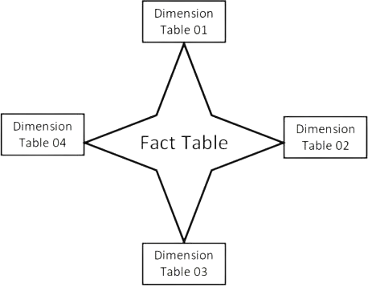

Conceptual Schema Design
PHILLIPS HEALTHCAREY
Conceptual schema design involves developing an overview of the data warehouse, including data sources, transformation policies, structure, metadata, and visual representation of data flow. It establishes the structure and organization of the data model, with input from data architects, analysts, and stakeholders.
KPIs and metrics for monitoring the data warehouse's success can be included, as well as data governance policies for quality, security, and integrity. It's a crucial part of Phillips Healthcare's implementation strategy, ensuring the data warehouse aligns with the organization's goals and objectives.

Slide 11
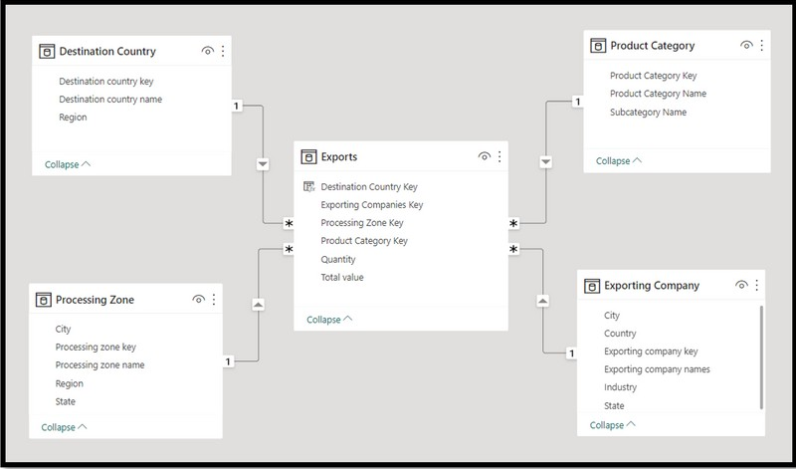

Dim Patient Table
Dim Facility Table
Patient Key
Facility Key
Patient ID Patient Name Patient DOB Patient Gender Patient Address
Facility ID Facility Name Facility Address Facility Type
Patients
Fact ID Patient ID Provider ID Facility ID
Outcome Type ID
Date of Service Cost
Dim Outcome Type Table
Dim Provider Table
Outcome Type Key Outcome Type ID Outcome Type Name
Provider Key Provider ID Provider Name Provider Specialty Provider Address
Outcome Type Description

Slide 12


Data Warehouse Architecture
PHILLIPS HEALTHCARE
The design of the data warehouse's logical and physical components is known as its architecture. The data warehouse design for Phillips Healthcare should incorporate the following important elements.
Data Storage Data Integration Data Modeling
Metadata Management Reporting and Analytics Security and Governance

Slide 13
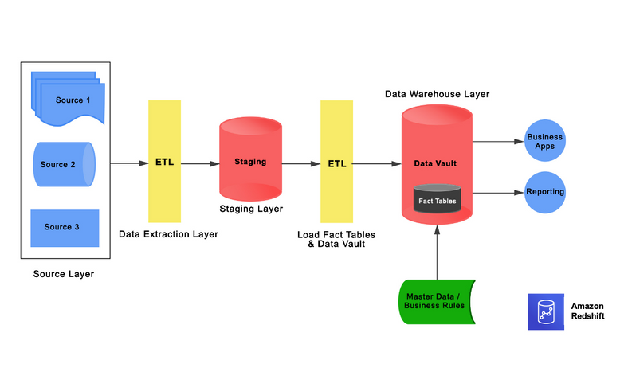

Hybrid Architecture
PHILLIPS HEALTHCARE
A hybrid data architecture might be a good fit for Philips Healthcare given the particular requirements and difficulties of the healthcare sector.
In order to provide a flexible and scalable solution, a hybrid data architecture combines the advantages of both on- premises and cloud-based systems. In Philips Healthcare's situation, a hybrid data architecture would enable secure on-premises processing and storage of private patient data while utilising cloud-based services for analytics and reporting.
Data Security and Privacy
Scalability with Cloud-Based Services Access to Data for Prompt Decision Making
Integrating existing systems using hybrid data Architecture

Slide 14






PHILLIPS HEALTHCARE
Analysis and reporting are important aspects of a data warehouse system in Philips Healthcare. Some important factors for successful analysis and reporting include data completeness and accuracy, data visualization, performance optimization, data security, and ad hoc reporting.
01
Analysis and reporting
In Phillips Healthcare, some important factors for analysis and reporting are as follows:
Phillips Healthcare can perform various analyses on the data in the data warehouse, such as clinical outcomes analysis and patient experience analysis, to improve patient care and satisfaction, reduce costs, and identify areas for improvement.
02
Reporting can facilitate access to data on patient care, financial performance, and operational efficiency for stakeholders such as physicians, administrators, and executives. Reports types that can be produced by Phillips Healthcare's data warehouse include clinical reports, financial reports, operational reports, and dashboards.
03
In order to better use resources, cut down on wait times, and improve patient outcomes, Phillips Healthcare may be able to identify bottlenecks and optimise procedures with the aid of operational efficiency analysis. For instance, reviewing patient flow and resource utilisation data could help staffing decisions be made more effectively and cut down on patient wait times.
04
Phillips Healthcare can also analyze provider performance by examining data on treatment outcomes, patient satisfaction ratings, and resource utilization. By identifying high-performing providers, the organization can share best practices and improve care quality across the board.
Additionally, by identifying underperforming providers, the organization can provide targeted training and support to improve outcomes.
05

Slide 15



REFERENCES
https://www.himss.org/ https://www.healthcareitnews.com/ https://www.healthdatamanagement.com/ https://www.himss.org/resources/journal- healthcare-information-management https://www.hcanews.com/

Slide 16

PHILLIPS HEALTHCARE
THANK YOU

